Slide 1

Project 1
The Ultimates

Slide 2

Overview
Walking as a primary mode of travel
Trends in highly walkable communities in relation to:
Car ownership
Income
Public transportation

Slide 3
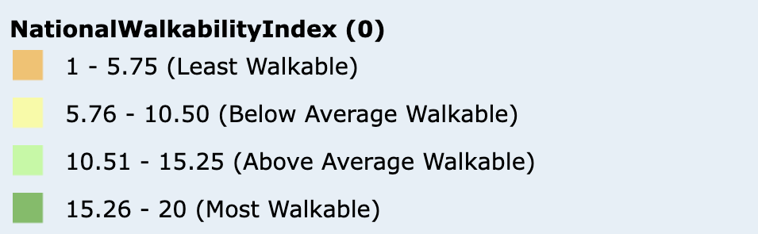
Data Source
Provided by EPA.gov
Looking at National Walkability Index in US and Puerto Rico
Data is at Census Block Group (CBG) level
National Walkability Score is based on many different factors such as street density, proximity to transit stops, diversity of area, and many more.

Slide 4

Analysis Questions
Do individuals living in a highly walkable area still choose to have a vehicle?
Do high income earners who live in a walkable community own car?
Do middle income earners who live in a walkable community own car?
Do low-income earners who live in a walkable community own car?
If individuals are within proximity to public transit stops and live in a walkable community, will they likely still own a vehicle?
Do individuals reside by their jobs or by their desire?

Slide 5

Pre-Analysis
Data Clean up & Findings
Refined data set to United States Only
Dropped missing values
Reduce size of data set size

Slide 6
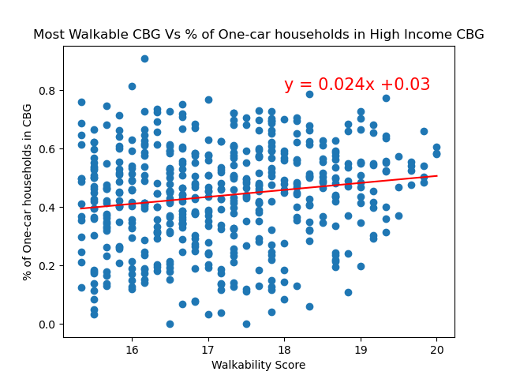
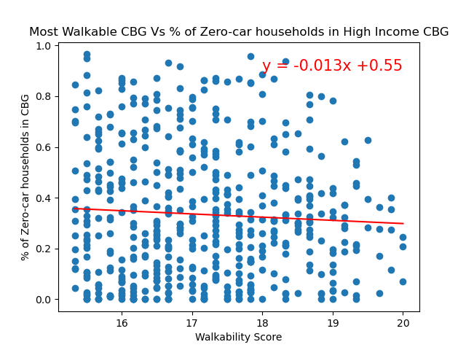
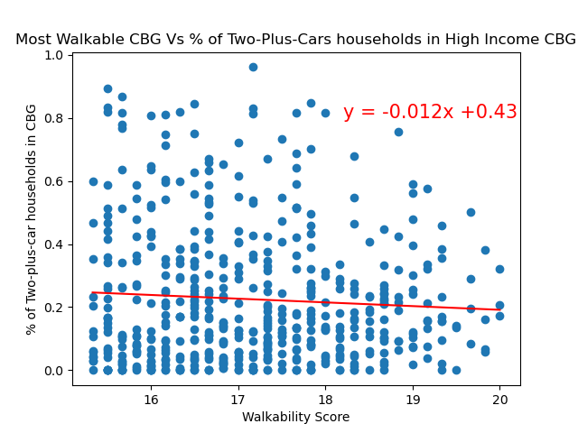
Analysis

Slide 7
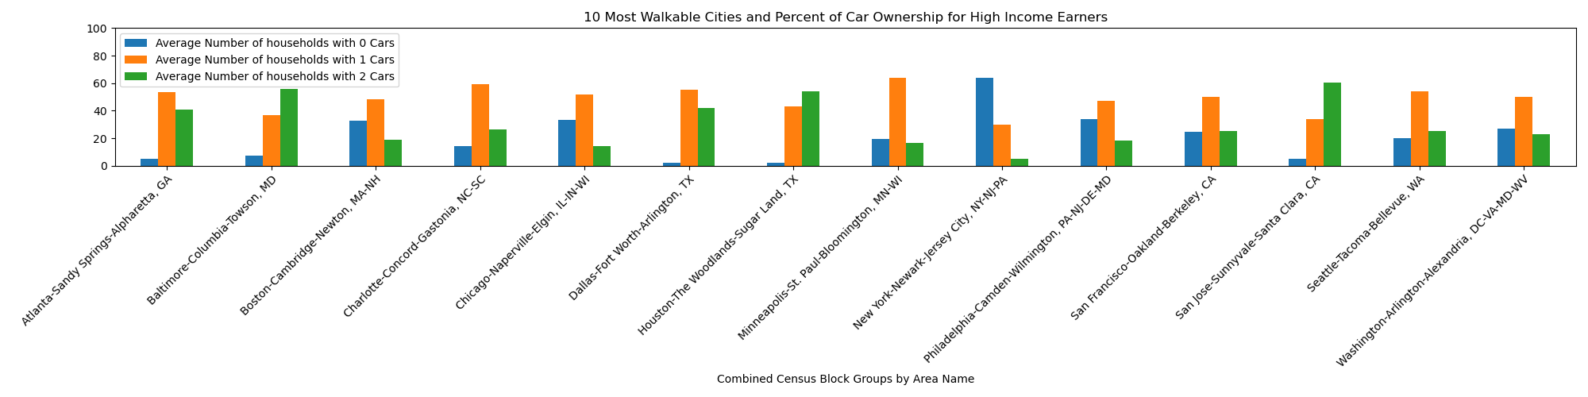
Analysis

Slide 8
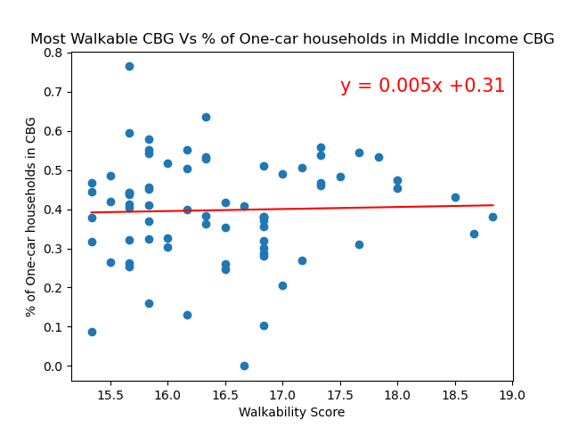
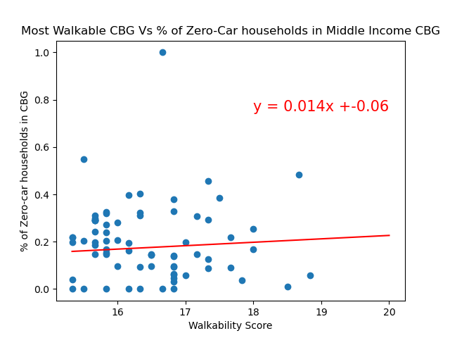
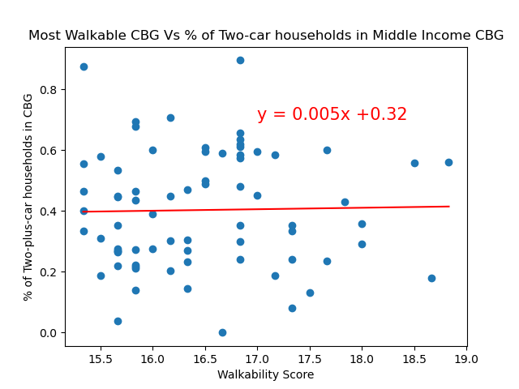
Analysis

Slide 9
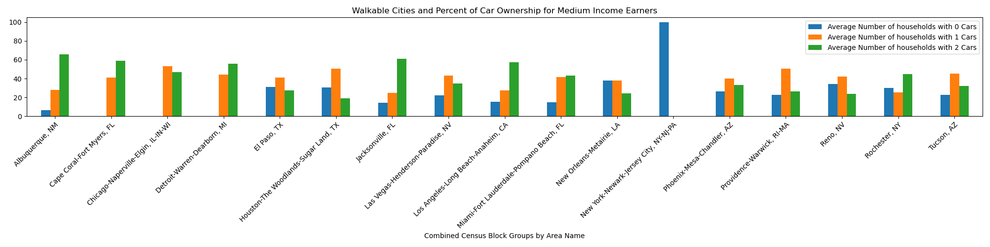
Analysis

Slide 10
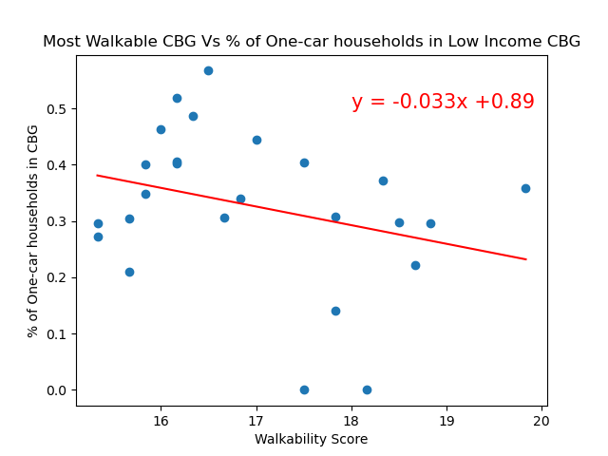
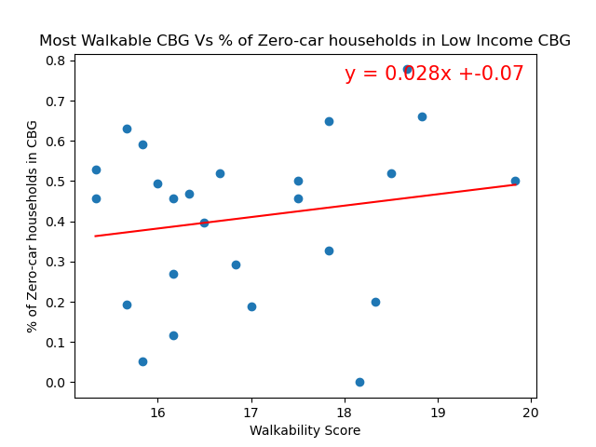
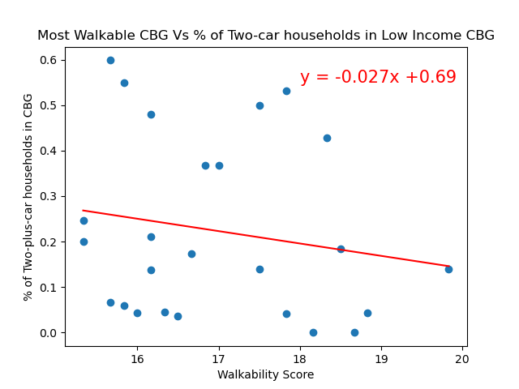
Analysis

Slide 11
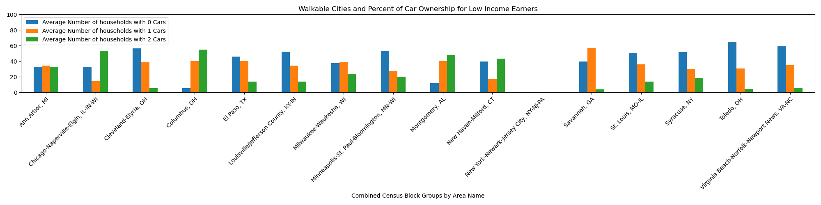
Analysis

Slide 12
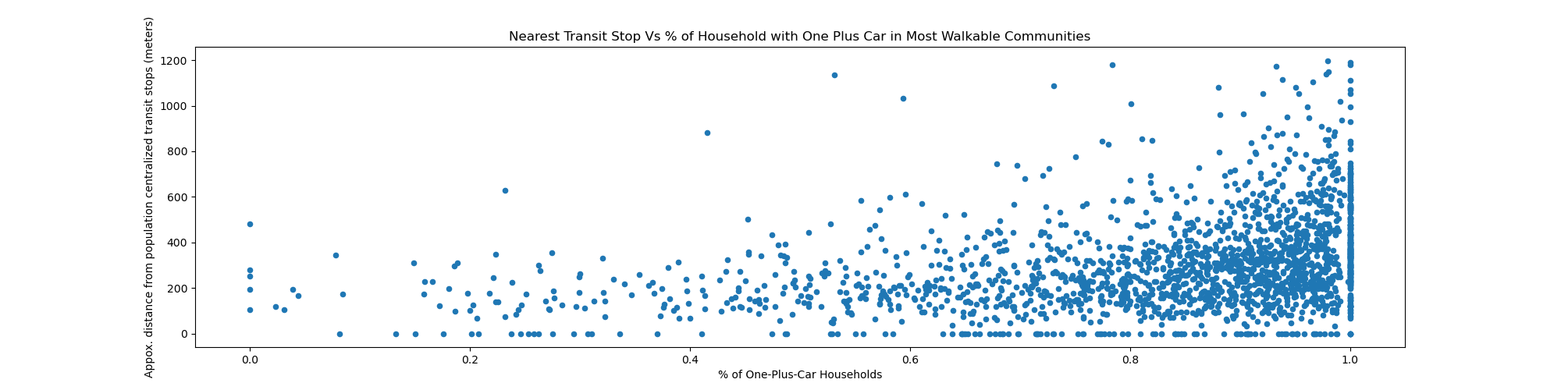
Analysis

Slide 13
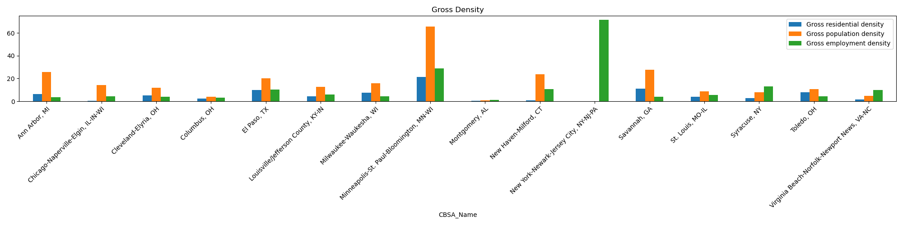
Analysis

Slide 14
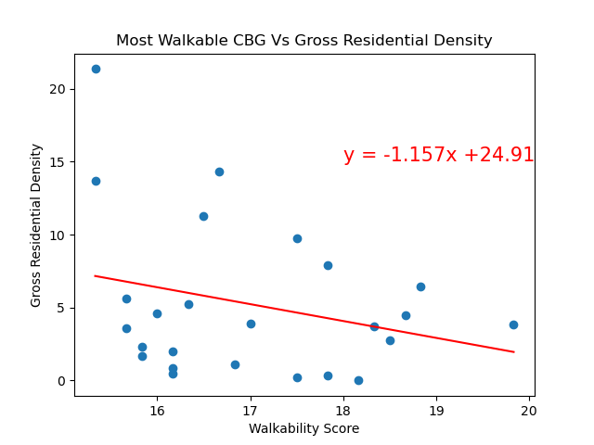
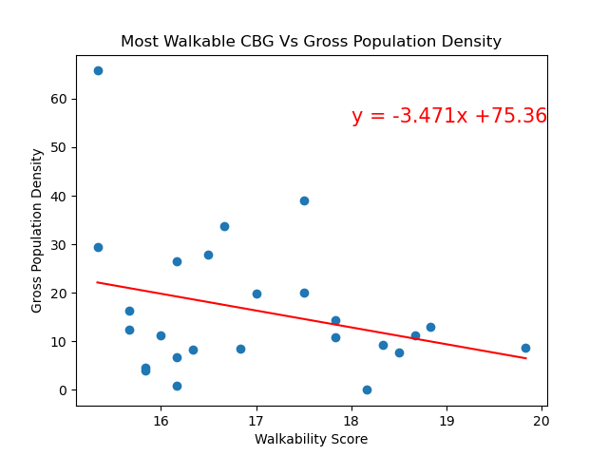
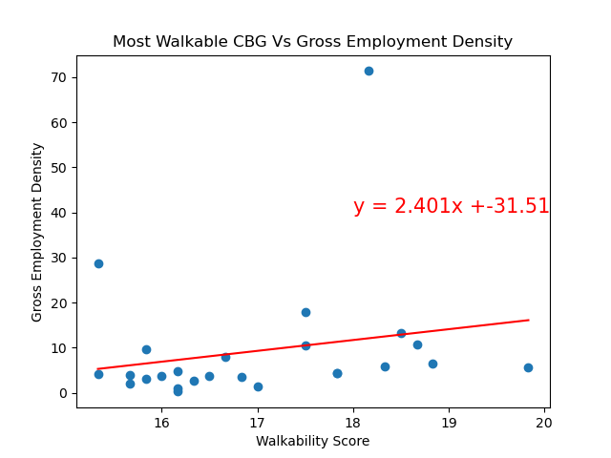
Analysis

Slide 15
Potential Future Analysis
Is it possible to influence purchasing behavior in walkable communities to be more eco-friendly?
Does living in a walkable community affect perceived happiness and well-being?

Slide 16
Conclusion
The data analysis does not show a clear indication that living in a walkable community affects car purchasing behavior in a consistent manner across income demographics
Whether you have high, middle, low income, or are near public transportation in a very walkable area, the average household would still own car in America
Data Bias:
Fixed income ranges across America in Dataset from EPA.gov

Slide 17
References
https://catalog.data.gov/dataset/walkability-index
https://edg.epa.gov/EPADataCommons/public/OA/WalkabilityIndex.zip
https://geodata.epa.gov/arcgis/rest/services/OA/WalkabilityIndex/MapServer

